Slide 1
Office Management System

Slide 2
Introduction
Definition:
An Office Management System (OMS) for HMIS is a system that manages the records of student regarding admission and examination part.
OMS involves
Managing personal information
Leave Management

Slide 3
Motivation
To meet a solution to manage employees’ and students’ records.
To overcome existing problems occurring in maintenance of information

Slide 4
Objectives
To manage students’ information during admission and examination.
Efficient utilization of human resource.
To reduce unnecessary paper work in maintaining students’ information

Slide 5
Need for Management system
Less error
Faster
No Record loss

Slide 6
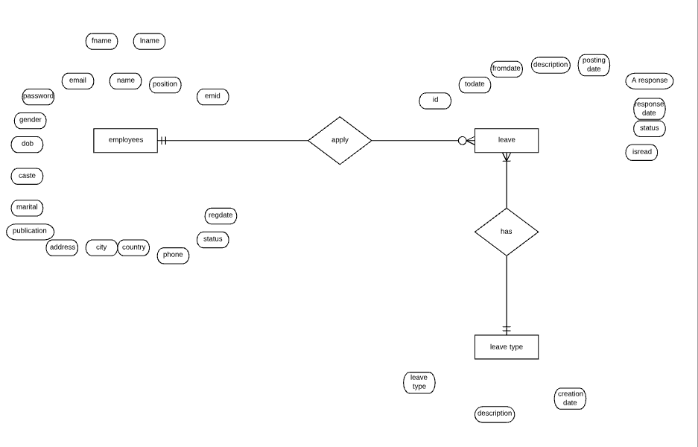
Employee ER-Diagram

Slide 7
ER- DIAGRAM

Slide 8
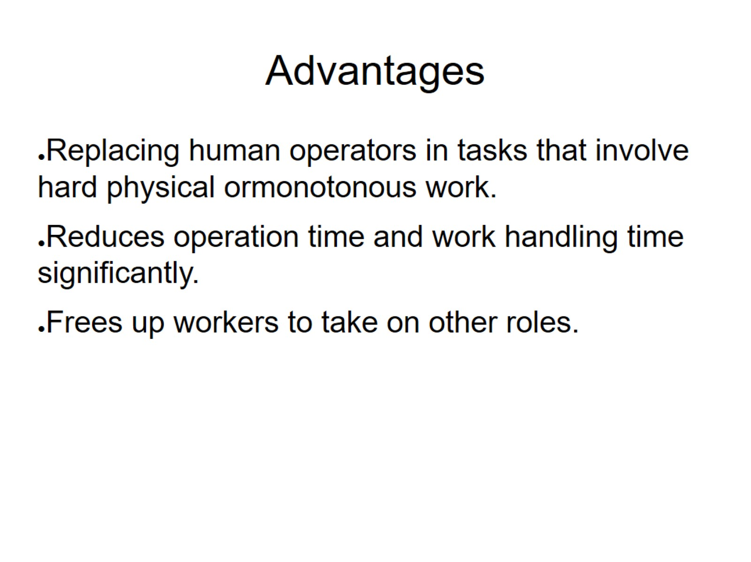
Advantages

Slide 9
THANK YOU

